Slide 1
Health Outcome Of 193 Countries
Presented By: Lilian Nwafor
A Cluster Analysis of outcome of health factors as regards to different countries.
1st December, 2022

Slide 2
Different countries of the world experience many challenges that affect the development of their economy and population growth. These incidences result to the following outcomes of which most countries hardly recover from. The outcome of these eventualities are as follows: Infants_dtp Infants_measles Infant_mortality Underfive_mortality Female_adult_mortality Male_adult_mortality Tuberculosis_Death Life_expectancy Physicians Public_health
INTRODUCTION
My aim of this project is to get the Euclidean distance between variables in and outside the clusters.
Determine which of the outcomes countries should have a occurrence preventive plans.
Discover the hierarchy of these outcomes.

Slide 3
APPROACH
Data Collection:
The data was collected from data.world: https://data.humdata.org/dataset/health-outcomes https://data.humdata.org/organization/undp-human-development-reports-office
Tools Used: R Statistical software was used for this analysis with Factoextra, cluster and stats libraries.
Exploratory Data Analysis:
The datasets contained 192 rows and 11 columns
Some columns were renamed to fit into the standard of cluster analysis.
Columns containing large number of missing values were dropped

Slide 4
STEPS TAKEN
Scaled the data because variables are measured in different scales to make variables more comparable. Compute distance measure Determine and visualize the optimal number of clusters Run the k-means algorithm and identifies the number of centroids Then allocates every data point to the nearest cluster, while keeping the centroids as small as possible. Computing k-means clusters on a data matrix Directly computing means using aggregate function Point classification of original data Visualizing clustering dendrogram i.e hierarchical clustering

Slide 5
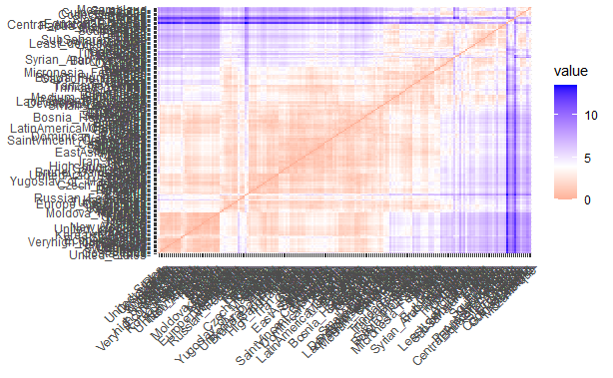
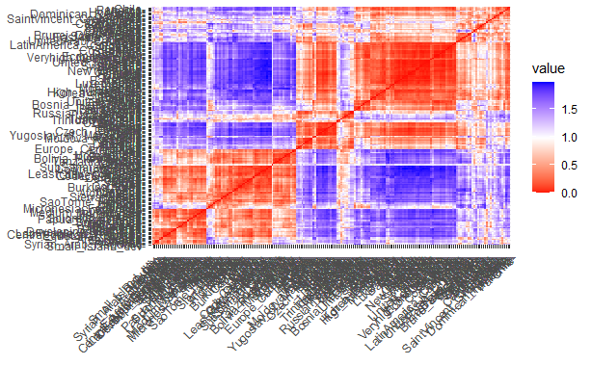
Euclidean Matrix
Correlation Matrix
The red color indicates high similarity while blue color indicates low similarity. The color level is proportional to the value of the similarity between observations where pure red represents 0 and pure blue represents 1.

Slide 6
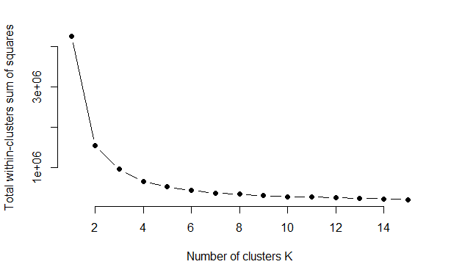
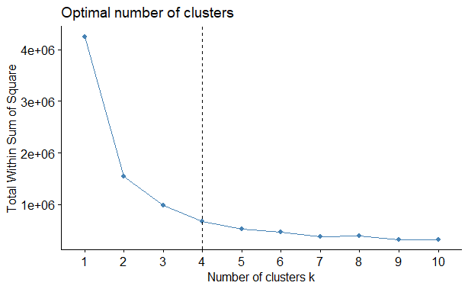
Total within cluster sum of square
Total within cluster sum of square with k indicator
The plot shows variances decreases as the k number increases. a bent on the elbow can be seen as k = 4 , meaning additional clusters beyond 4 has little values. Let's classify our observations into 4 clusters

Slide 7
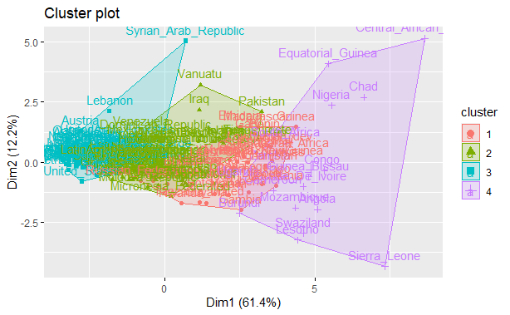
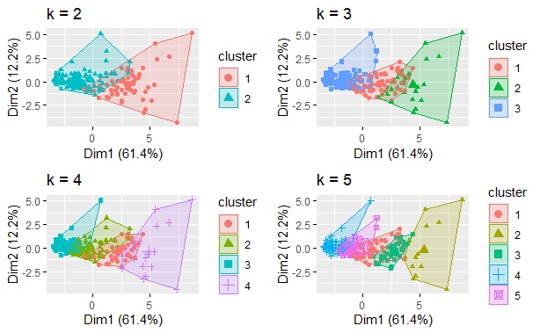
Cluster Plot of K=4
Cluster Plot of K=2,3,4,5
I plotted the centroid of 2,3,4,5, to find the right plot for the analysis and chose 4 because the bent is at 4 which is considered as an indicator of the optimal number of clusters.

Slide 8
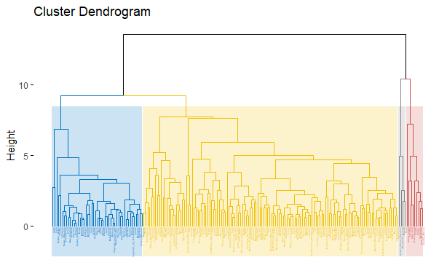
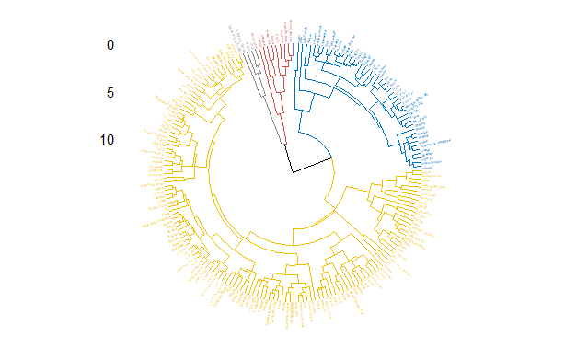
Cluster Dendrogram
Dendrogram Plot

Slide 9
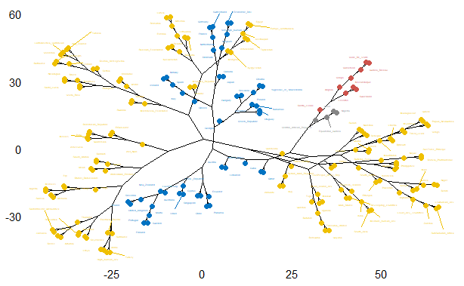
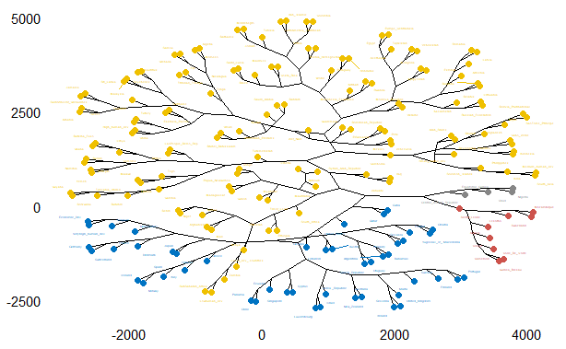
Other Plot Style
My aim of this project is to get the Euclidean distance between variables in and outside the clusters.
Determine which of the outcomes countries should have a occurrence preventive plans.
Discover the hierarchy of thse outcomes.

Slide 10
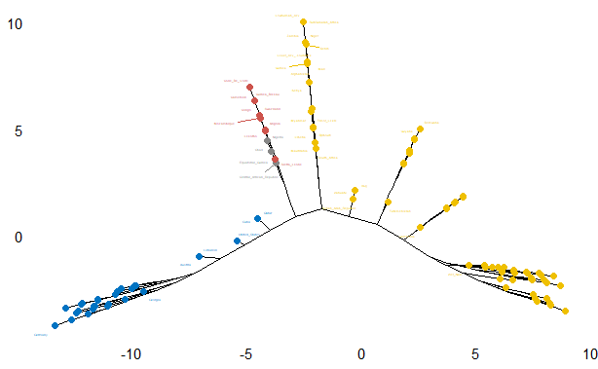
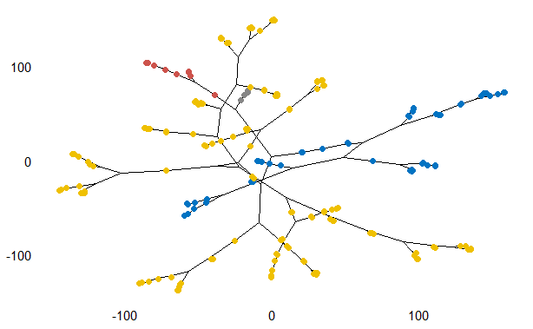
Other Plot Style

Slide 11
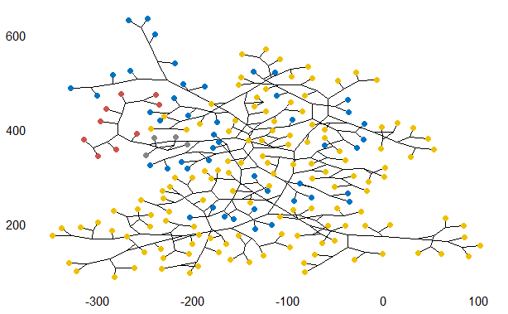
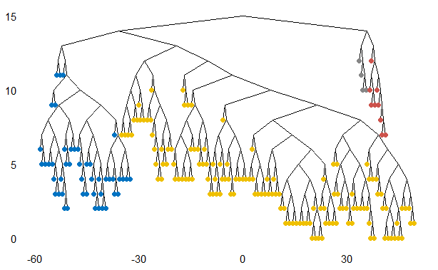
Othe Plot Styles

Slide 12
Challenges
It took a long time to vet the dataset due to the nature of cluster analysis, considering the large number of rows and columns.
conclusion
Clustering variables is a good unsupervised learning algorithm to group features of similarities with o distance.
suggestion
Preventive measure should be put in place to avoid incidences that will badly affect the economies of countries, especially the underdeveloped and developing countries.

